Slide 1
Automated Washing Machine System using Arduino
A Microprocessors and Microcontrollers Project
-Ronit Ray (19) and Subhadeep Biswas (20)
CSE-3A, University of Engineering and Management, Kolkata

Slide 2
Acknowledgements
This project was very challenging and we thank Prof. Indranil Banerjee, Prof. Soma Bhattacharya, Prof. Soham Nandi Roy, Prof. Debkumar Chowdhury, and Prof. Subhabrata Sengupta for their guidance throughout the semester, and for introducing the subject to us in a lucid and engaging manner.
We regret our inability to implement this project on the Intel 8051 platform, partly due to inability to understand hardware interfacing and programming on it, and partly due to its unavailability on short notice in Kolkata. We hope this project is acceptable and shows what we have learned over the last few months.

Slide 3
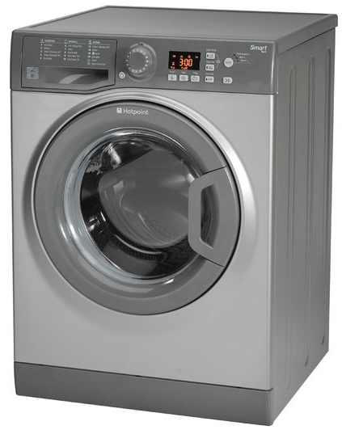
Introduction
A washer or washing machine is an electronic device used to wash laundry like clothing and sheets.
It is a specialized device that makes use of a microcontroller to integrate a number of functions and automate them for a unified washing and drying process.

Slide 4
Operation of a Washing Machine
The clothes are loaded into the receptacle.
Detergent is added.
A pump fills the receptacle with water.
The receptacle is now rotated clockwise and anticlockwise repeatedly to ensure that all clothes are exposed to the water-detergent mixture and are also cleaned due to interaction with this mixture and friction due to rubbing against each other.
Another pump now drains the receptacle of water and detergent.
A fan will dry the clothes in the receptacle before they are extracted.

Slide 5
Project Implementation
Due to financial constraints and since a water pump was not available in the market at the time of implementation, we have decided to keep the water filling and draining processes manual for this project.
This reduces the project to three integrated components:
The Water Level Sensor which detects when enough water has been poured into the receptacle
The Motor which will rotate the receptacle
The Fan which will dry the receptacle.

Slide 6
Components Used
Name | Price
Arduino Uno R3 | 500
12V DC Motor | 200
5V DC motor | 150
Motor Driver DRV8825 | 200
Water Level Sensor | 150
DC Motor Fan | 100
Buzzer | 50
Jumper Wires | 50
Breadboard | 100

Slide 7
Operational Algorithm
Water is poured into receptacle
If sensor.level > 600 then
Buzzer alert
Repeat 5 times
Rotate motor clockwise 5s
Rotate motor anticlockwise 5s
Buzzer alert
Wait 10s while water is drained.
Run fan 15s
Buzzer alert for completion

Slide 8
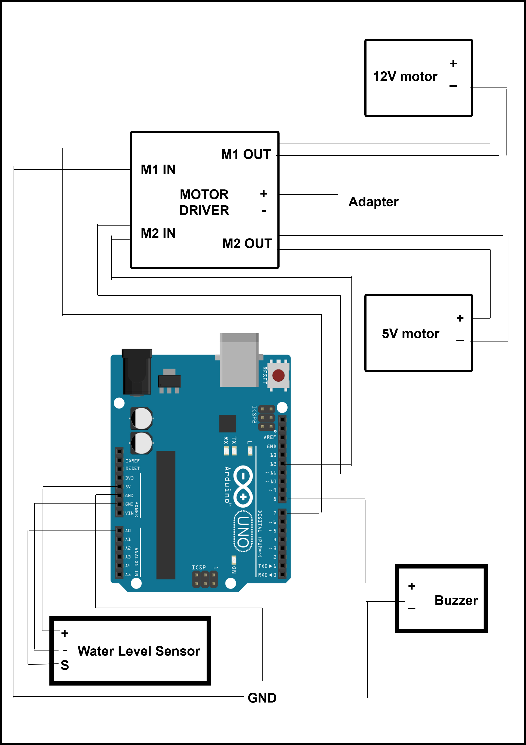
Circuit Design

Slide 9
Arduino Code
void setup()
{
pinMode(A0,INPUT);//Water Level pinMode(8,OUTPUT);//Buzzer pinMode(7,OUTPUT);//Fan pinMode(11,OUTPUT); pinMode(12,OUTPUT);//Motor
Serial.begin(9600);
}

Slide 10
Arduino Code (contd.)
void loop()
{
int a=analogRead(A0);
Serial.println(a);
if(a>600){
digitalWrite(8,HIGH);
delay(3000);
digitalWrite(8,LOW);
for(int i=1;i<=5;i++)
{
digitalWrite(11, HIGH);
digitalWrite(12,LOW);
delay(5000);
digitalWrite(12, HIGH);
digitalWrite(11, LOW);
delay(5000);
digitalWrite(11,LOW);
digitalWrite(12,LOW);
}

Slide 11
Arduino Code (contd.)
digitalWrite(8,HIGH); delay(3000);
digitalWrite(8,LOW); delay(10000);
digitalWrite(7,HIGH); delay(15000);
digitalWrite(7,LOW);
digitalWrite(8,HIGH);
delay(3000);
digitalWrite(8,LOW);
delay(10000);
}
}

Slide 12
Conclusion
The project was implemented successfully. A video of the operation can be found at https://www.youtube.com/channel/UCb9fthBo074O1fgcjHbYeag
For future scope, we would like to use pumps for the water inflow and drainage processes. The project serves as a proof of concept that a microcontroller can be used to automate the working of a washing machine.

Slide 13
References
Tutorials:
https://www.arduino.cc/en/Tutorial/HomePage
https://home.howstuffworks.com/washer.htm

Slide 14
References (contd.)
Datasheets
Arduino UNO: http://datasheet.octopart.com/A000066-Arduino-datasheet-38879526.pdf
ATmega 328p Microcontroller: http://www.atmel.com/images/Atmel-8271-8-bit-AVR-Microcontroller-ATmega48A-48PA-88A-88PA-168A-168PA-328-328P_datasheet_Complete.pdf
Water Level Sensor: http://www.fecegypt.com/uploads/dataSheet/1480850810_water.pdf https://www.emartee.com/Attachment.php?name=42240.pd
Motor Driver: https://www.ti.com/lit/ds/symlink/drv8825.pdf
Buzzer: http://www.farnell.com/datasheets/2171929.pdf

